Slide 1
Game Theory

Slide 2
Why Game?
Games are fun!
Studying games teaches us how to deal with other agents trying to foil our plans
Huge state spaces – Games are hard!
Nice, clean environment with clear criteria for success.
Two-player games
The objective of a search is to find a path from the starting position to a goal position
In a two-player competitive game, you alternate moves with the other player
The other player doesn’t want you to reach your goal
Your search technique must be very different

Slide 3
Payoffs
Payoff = The value associated with a possible outcome of a game.
Strategy = A rule of action for playing a game. An optimal strategy is one that provides the best payoff for a player in a game.
Each game outcome has a payoff, which we can be represented as a number
By convention, we prefer positive numbers
In some games, the outcome is either a simple win (+1) or a simple loss (-1)
In some games, you might also tie, or draw (0)
In other games, outcomes may be other numbers (say, the amount of money you win at Poker)

Slide 4
Key Properties
Zero-sum games:
Most common games are zero-sum: What one player win ($12), plus what other player(opponent) win (-$12), equals zero.
Not all games are zero-sum games
From our point of view, positive numbers are good, negative numbers are bad
From our opponents point of view, positive numbers are bad, negative numbers are good.
Perfect Information: each player knows the entire game state
Deterministic: no element of chance. Clear set of legal moves
Utility function: Gives numerical value of terminal states. E.g. win (+1), lose (-1) and draw (0) in tic-tac-toe
Evaluation function(f): assigns real-number scores to each game state (board position)

Slide 5
How to Play a Game by Searching
General Scheme
Consider all legal moves, each of which will lead to some new state of the environment (‘board position’)
Evaluate each possible resulting board position
Pick the move which leads to the best board position.
Wait for your opponent’s move, then repeat.
Key problems
Representing the ‘board’
Representing legal next boards
Evaluating positions
Looking ahead

Slide 6
Heuristics
In a large game, you don’t really know the payoffs
A heuristic function computes, for a given node, what the payoff will be.
The heuristic function uses whatever knowledge you can build into the program
We make two key assumptions:
Your opponent uses the same heuristic function as you do
The more moves ahead you look, the better your heuristic function will work

Slide 7
Minimax strategy
In minimax, one player will choose maximum number and other player(opponent) will choose minimum number.
Strategy:
Explore down to a given level using depth-first search
As you reach each lowest-level node, evaluate it using your heuristic function
Back up values to the next higher node, according to the following rules:
If it’s your move, bring up the largest value, possibly replacing a smaller value
If it’s your opponent’s move, bring up the smallest value, possibly replacing a larger value
At your move, never reduce a value
At your opponent’s move, never increase a value

Slide 8
Minimaxing
• Your opponent will choose smaller numbers
3
• If you move left, your opponent will choose 3
Your move
• If you move right, your opponent will choose -8
3
-8
Opponent’s move
• Therefore, your choices are really 3 or -8
7
3
-8
5
• You should move left, and play will be as shown

Slide 9
Minimax (animated)
• Do a DFS; find an 8 and bring it up
Your move
• Explore 5; smaller than 8, so ignore it
• Backtrack; bring 8 up another level
8
• Explore 2; bring it up
Opponents move
• Explore 9; better than 2, so bring it up, replacing 2
8
2
9
• 9 is not better than 8 (for your opponent), so ignore it
Your move
• Explore –3, bring it up
8
5
2
9
-3
• Etc.
Use heuristic function at leap nodes

Slide 10
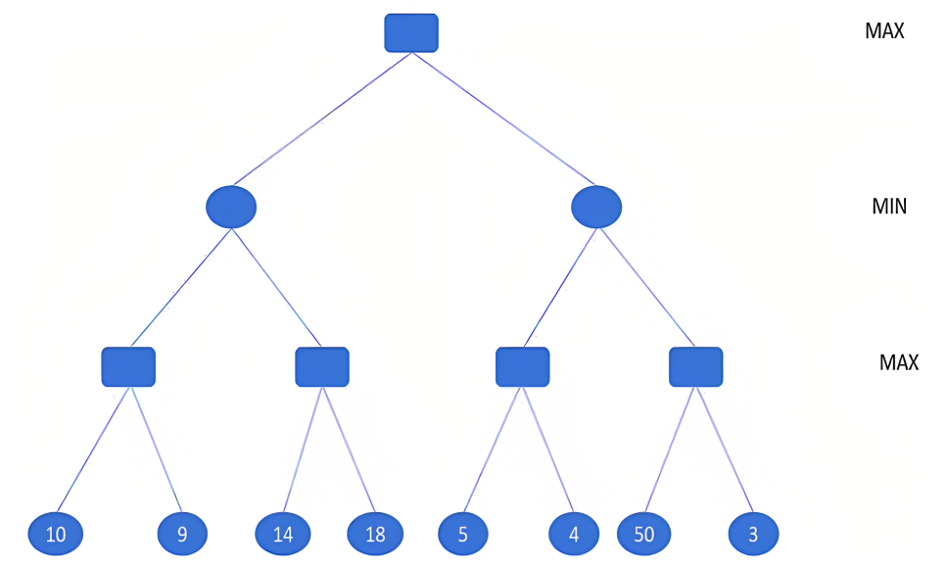
Example Find the utility value and the direction of the next move for the MAX player at the root using minimax.

Slide 11
Alpha-beta pruning:
The problem with minimax search is that the number of game states is to examine is exponentially large.
We can use pruning to eliminate large parts of the tree from consideration
Alpha-beta pruning returns appropriate minimax decision without exploring entire tree.
Strategy:
Alpha = the value of the best choice we’ve found so far for MAX (highest)
Beta = the value of the best choice we’ve found so far for MIN (lowest)
When maximizing, cut off values lower than Alpha
When minimizing, cut off values greater than Beta

Slide 12
Alpha cutoffs
8
The value at your move is 8 (so far)
If you move right, the value there is 1 (so far)
Your opponent will never increase the value at this node; it will always be less than 8
You can ignore the remaining nodes
Your move
alpha cutoff
8
1
Opponents move
8
9
1
Your move
8
5
2
9
-3
1

Slide 13
Alpha cutoffs, in more detail PAV = preliminary backed-up value
parent (has PBV of 8)
node being examined
You have an alpha cutoff when:
You are examining a node at which it is your opponent’s move, and
You have a PBV for the node’s parent, and
You have brought up a PBV that is less than the PBV of the node’s parent, and
The node has other children (which we can now “prune”)
8
Your move
alpha cutoff
8
1
Opponents move
8
9
1
Your move
8
5
2
9
-3
1

Slide 14
Beta cutoffs
An alpha cutoff occurs where
It is your opponent’s turn to move
You have computed a PBV for this node’s parent
The node’s parent has a higher PBV than this node
This node has other children you haven’t yet considered
A beta cutoff occurs where
It is your turn to move
You have computed a PBV for this node’s parent
The node’s parent has a lower PBV than this node
This node has other children you haven’t yet considered

Slide 15
Using beta cutoffs
Beta cutoffs are harder to understand, because you have to see things from your opponent’s point of view
Your opponent’s alpha cutoff is your beta cutoff
We assume your opponent is rational, and is using a heuristic function similar to yours
Even if this assumption is incorrect, it’s still the best we can do

Slide 16
The importance of cutoffs
If you can search to the end of the game, you know exactly how to play
The further ahead you can search, the better
If you can prune (ignore) large parts of the tree, you can search deeper on the other parts
Since the number of nodes at each level grows exponentially, the higher you can prune, the better
You can save exponential time

Slide 17
Example Find the utility value and the direction of the next move for the MAX player at the root using Alpha-beta pruning.

